Slide 1
Formula 1 Prediction & Data Analysis
Final Year Project – Demo
Eoin Farrell
Deirdre Lawless
Notes:
Chosen due to interest in the sport and an interest in data mining prediction (from previous work experience at BOI)
Data mining in sports - growing field of investigation, many sports use it such as baseball to chose players to buy and rugby & soccer to predict player injuries
In formula 1 data plays a large role with cars fitted with 160+ sensors to read that, this data has to be interpreted somehow
This data feeds teams strategies
An area that hasn’t been investigated from my research is f1 prediction, nascar prediction has been researched so was used as a reference point

Slide 2
Project Overview
Project focused on the development of a web application, allowing users to predict Formula 1 (F1) race results using data mining techniques.
Linear Regression utilised for prediction algorithm.
Large data collection required and correlation testing used to support this.
Additional goals include expanding the web application to build a user community.
User community achieved by allowing users to login and compete against one another with their predictions.

Slide 3
Project Aims & Objectives
Research & locate F1 data for previous season race performance
Design & develop dataset to support prediction model
Initial dataset testing through RapidMiner
Implement linear regression algorithm for race prediction
Design & develop web application
Expand application to provide user community features
Plan and execute usability testing of web application and testing of the prediction algorithm

Slide 4
Formula 1 Data Overview
Year | Car Number | Driver | Circuit | Previous Race -3 | Previous Race -2 | Previous Race -1 | FP3 TIME | FP3 RANK | START POS | FINSIH POS
2010 | 1 | J.Button | China | 7 | 1 | 8 | 1'35.747 | 4 | 5 | 1
2010 | 2 | L.Hamilton | China | 3 | 6 | 6 | 1'35.564 | 2 | 6 | 2
2010 | 3 | M.Schumacher | China | 6 | 10 | 0 | 1'36.262 | 7 | 9 | 10
2010 | 4 | N.Rosberg | China | 5 | 5 | 3 | 1'35.913 | 6 | 4 | 3
2010 | 5 | S.Vettel | China | 4 | 0 | 1 | 1'35.691 | 3 | 1 | 6
2010 | 6 | M.Webber | China | 8 | 9 | 2 | 1'35.323 | 1 | 2 | 8
2010 | 7 | F.Massa | China | 2 | 3 | 7 | 1'36.416 | 9 | 7 | 9
2010 | 8 | F.Alonso | China | 1 | 4 | 13 | 1'35.857 | 5 | 3 | 4
2010 | 9 | R.Barrichello | China | 10 | 8 | 12 | 1'37.585 | 16 | 11 | 12
2010 | 10 | N.Hulkenberg | China | 14 | 0 | 10 | 1'37.784 | 18 | 16 | 15
2010 | 11 | R.Kubica | China | 11 | 2 | 4 | 1'36.343 | 8 | 8 | 5
2010 | 12 | V.Petrov | China | 0 | 0 | 0 | 1'37.339 | 15 | 14 | 7
2010 | 14 | A.Sutil | China | 12 | 0 | 5 | 1'37.240 | 14 | 10 | 11
2010 | 15 | V.Liuzzi | China | 9 | 7 | 0 | 1'37.031 | 12 | 18 | 0
2010 | 16 | S.Buemi | China | 16 | 0 | 11 | 1'37.192 | 13 | 13 | 0
2010 | 17 | J.Alguersuari | China | 13 | 11 | 9 | 1'36.879 | 11 | 12 | 13
2010 | 18 | J.Trulli | China | 17 | 0 | 17 | 1'39.776 | 22 | 20 | 0
2010 | 19 | H.Kovalainen | China | 15 | 13 | 0 | 1'39.616 | 20 | 21 | 14
2010 | 20 | K.Chandhok | China | 0 | 14 | 15 | 1'41.141 | 24 | 24 | 17
2010 | 21 | B.Senna | China | 0 | 0 | 16 | 1'40.316 | 23 | 23 | 16
2010 | 22 | P.diResta | China | 0 | 12 | 0 | 1'37.664 | 17 | 17 | 0
2010 | 23 | K.Kobayashi | China | 0 | 0 | 0 | 1'36.634 | 10 | 15 | 0
2010 | 24 | T.Glock | China | 0 | 0 | 0 | 1'39.579 | 19 | 19 | 0
2010 | 25 | L.Grassi | China | 0 | 0 | 14 | 1'39.749 | 21 | 22 | 0
Data for 2013 F1 season collected from Formula1.com (PDF format)
Data for 2010 – 2012 F1 season collected from Forix.com (web data)
5 features chosen for the prediction model using correlation testing
Notes:
First explain the 2013 data and how you collected it – all the different features
How this was witteled down to the chosen features
Then explain the collection of 2010-2012 data, where and how this was achieved
Then explain that the above is a sub set of the complete dataset showing one race

Slide 5
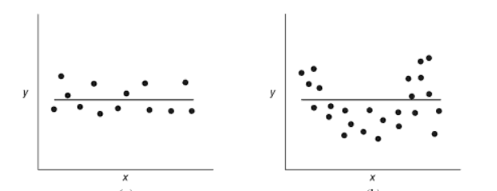
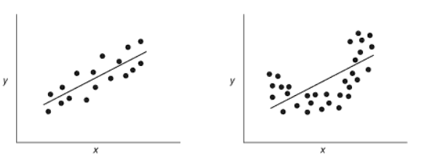

Multiple Regression Overview
Simple Linear Regression
Multivariate linear regression
Equation of the line: Y = mx + b
Prediction formula:
Y’ = B₀ + B₁x + e
$B_{1}^{′}=\frac{\sum_{i=1}^{n}{\left(x_{i}−\overline{x}\right)\left(y_{i}−\overline{y}\right)}}{{\left(x_{i}−\overline{x}\right)}^{2}}$
$B_{0}^{′}=\overline{y}−{B′}_{1}\overline{x}$
Prediction formula:
Y’ = B₀ + B₁X + B₁X + …. + B_{k}X + e
Matrix form: Y’ = XB’ + e
B’ = (X^{T}X)⁻¹ X^{T}Y
Notes:
First go over what linear regression is, how it trys to fit a line to data points
This line trys to minise the distance from it to all points (least squares method)
Then go over simple linear regression
How this does not translate to multiple so why a different method is used
Then go over multiple linear regression and matrix form
State what a matrix transpose (flip the data) is and what a matrix inverse (1/n * n = I = 1) is
State how and why this didn’t work, couldn’t get matrix inverse
State how adopted simple linear regression
State how I am looking into gradient descent for linear regression maybe explain what it is
Move onto application

Slide 6
Development & Testing Approach
CRISP-DM utilised for data collection and dataset testing methodology.
Scrum chosen as design methodology for algorithm and web application development.
Development divided into three sprints
Usability testing utilised to gather an understanding of user perception towards web application.
Unit testing used to pinpoint problems within the server classes, including linear regression algorithm.
Developer testing used throughout project to evaluate new application features.

Slide 7
Technology
Web application hosted on Google App Engine with Google Cloud SQL as a relation database.
Advantages of Google cloud hosting:
Low cost
Free, public web domain
Stability and consistency
Focus on security with automatic data encryption
Java utilised for server side logic
JSON data format used to pass data from client to server and back with GSON API to parse data.
HTML, CSS, Greensock API and AngularJS used for front end web development.
Notes:
Mention java was chosen as I know it and it is used for both RapidMiner and Weka developed in it.
AngularJS used instead of JavaScript as it allowed the separation of the application view and data

Slide 8
Conclusion
Successfully developed web application for predicting F1 race results.
Positive user feedback from testing and project fair.
Testers continuing to make predictions for races after the testing period.
Improved understanding of project planning and implementation.
Enhanced knowledge of data mining and prediction techniques.
Greater awareness on the design of websites for user communities.

Slide 9
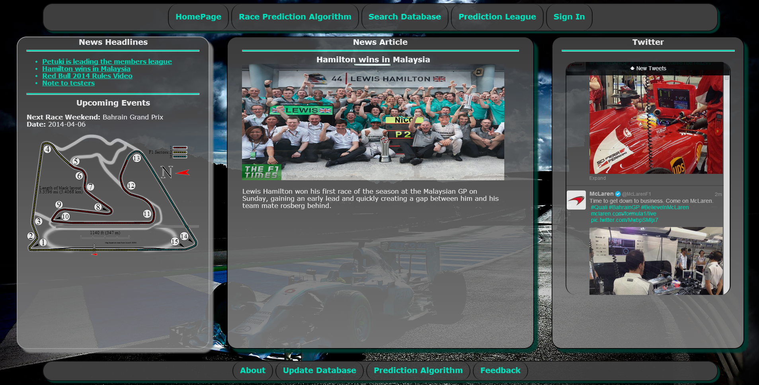
Questions

